Slide 1

What’s new in ASP.NET Core 3.0
Scott Addie
@Scott_Addie

Slide 2
.NET 5
.NET
.NET FRAMEWORK
.NET CORE
.NET
XAMARIN / MONO
Runtime (JIT & Native)
Runtime
Runtime
Runtime
One Base Class Library
Base Class Library
Core Library
Mono Class Library
.NET STANDARD
Notes:
2019 – Introduce .NET 5 – Windows, Mac, Linux, Android, IOS all run .NET Core’s runtime
Same BCL used on all platforms, same runtime used on all platforms
Native code compilation on all platforms, by merging .NET Native and Mono AOT
JIT and AOT Runtime
.NET 5 is the next major version of the .NET Platform that brings technologies from .NET Framework, .NET Core and & Mono runtimes and frameworks together into one .NET platform.
.NET 5 will have one Base Class Library (BCL) that will contain APIs for building any type of application. All .NET workloads are supported with application frameworks including cross-platform web development with ASP.NET, iOS and Android mobile development with Xamarin, Windows Desktop, and cross-platform IoT.
.NET 5 will have both Just-in-Time (JIT) and Ahead-of-Time (AOT) compilation models for the multiple compute and device scenarios it must support. JIT has better performance for server and desktop workloads as well as development environments. AOT has better startup, a small footprint, and is required for mobile and IoT devices.
.NET 5 will also have one unified toolchain supported by new SDK project types, will have a flexible deployment model (Side-by-Side and self-contained EXEs) and continue .NET Core's superior performance for server & cloud workloads.

Slide 3
ASP.NET Core 3.0
ASP.NET Core 2.2
.NET FRAMEWORK
.NET CORE
Runtime
Runtime
Base Class Library
Core Library
.NET STANDARD 2.1
.NET STANDARD 2.0
Notes:
2019 – Introduce .NET 5 – Windows, Mac, Linux, Android, IOS all run .NET Core’s runtime
Same BCL used on all platforms, same runtime used on all platforms
Native code compilation on all platforms, by merging .NET Native and Mono AOT
JIT and AOT Runtime
.NET 5 is the next major version of the .NET Platform that brings technologies from .NET Framework, .NET Core and & Mono runtimes and frameworks together into one .NET platform.
.NET 5 will have one Base Class Library (BCL) that will contain APIs for building any type of application. All .NET workloads are supported with application frameworks including cross-platform web development with ASP.NET, iOS and Android mobile development with Xamarin, Windows Desktop, and cross-platform IoT.
.NET 5 will have both Just-in-Time (JIT) and Ahead-of-Time (AOT) compilation models for the multiple compute and device scenarios it must support. JIT has better performance for server and desktop workloads as well as development environments. AOT has better startup, a small footprint, and is required for mobile and IoT devices.
.NET 5 will also have one unified toolchain supported by new SDK project types, will have a flexible deployment model (Side-by-Side and self-contained EXEs) and continue .NET Core's superior performance for server & cloud workloads.

Slide 4


.NET Framework unsupported
WebApp.csproj
<Project Sdk="Microsoft.NET.Sdk.Web"> <PropertyGroup> <TargetFramework>netcoreapp3.0</TargetFramework> </PropertyGroup> </Project>
Notes:
ASP.NET Core 3.0 built on .NET Standard 2.1
.NET Standard is first version to NOT support .NET Framework

Slide 5
Supported ASP.NET Core variants
3.0 on .NET Core 3.0
2.2 on .NET Core 2.2
2.1 on .NET Core 2.1
2.1 on .NET Framework 4.6.x
Current
Maint.
LTS
LTS
Notes:
3.1 = LTS

Slide 6
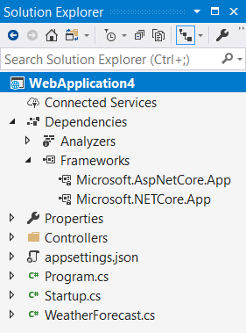
Implicit Shared Framework reference
Web SDK includes the following:
<ItemGroup>
<FrameworkReference Include="Microsoft.AspNetCore.App" />
</ItemGroup>
Remove metapackage reference when migrating:
<ItemGroup>
<PackageReference Include="Microsoft.AspNetCore.App" />
</ItemGroup>

Slide 7

Episode III
A NEW RELEASE
It is a period of assembly removal from the ASP.NET Core shared framework. Caffeinated engineers, working from a building in Redmond, have made tough decisions…
Notes:
Remove things the ASP.NET Core team doesn’t own:
Azure SDK
EF Core

Slide 8

Assemblies removed from Shared Framework
Json.NET
Microsoft.AspNet.WebApi.Client
Roslyn (Microsoft.CodeAnalysis.*)
EF Core
Social auth
Node Services & SPA Services
Notes:
WebApi.Client: had a dependency on Json.NET
Roslyn:
ships on the VS schedule, which differs from the .NET Core release lifecycle
some customers don’t want compilers in there for security reasons
Social auth: Facebook, Google, Microsoft, Twitter

Slide 9
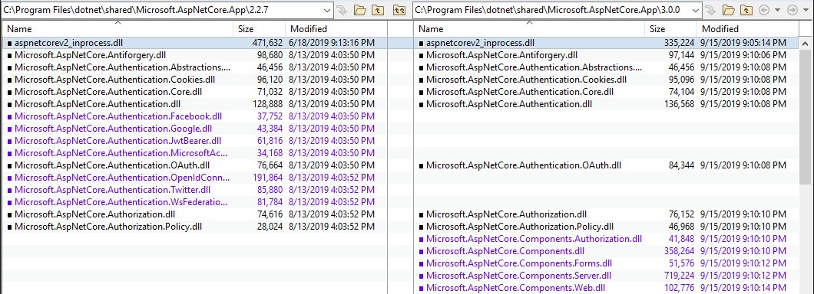
Shared Framework: 2.2 vs. 3.0

Slide 10
C# 8 support
[HttpGet("asyncsale")]
public async IAsyncEnumerable<Product> GetOnSaleProductsAsync()
{
var products = _repo.GetProductsAsync();
await foreach (var product in products)
{
if (product.IsOnSale)
{
yield return product;
}
}
}
Notes:
GetProductsAsync returns an IAsyncEnumerable<Product>
This is a non-blocking action as of 3.0
MVC buffers any concrete type that implements IAsyncEnumerable<T> before sending it to the serializer

Slide 11

Blazor

Slide 12
System.Text.Json

Slide 13
Endpoint routing

Slide 14
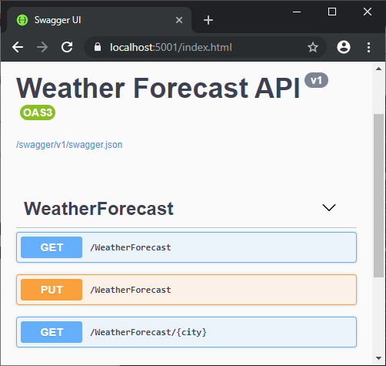
HTTP REPL
Command-line HTTP testing
Localhost
Cloud-hosted
Azure App Service
Azure Functions
Endpoint navigation
Requires Swagger / OpenAPI definition
AuthN / AuthZ support
.NET Core Global Tool:
dotnet tool install –g Microsoft.dotnet-httprepl
Notes:
Requires .NET Core 2.1+
Auth schemes achievable via header manipulation
Basic authN
JWT bearer tokens
Digest authN

Slide 16
Developer Exception Page plain text support
[ApiController]
[Route("[controller]")]
public class WeatherForecastController : ControllerBase
{
[HttpGet("{city}")]
public ActionResult<WeatherForecast> Get(string city)
{
if (!string.Equals(city?.TrimEnd(), "Redmond",
StringComparison.OrdinalIgnoreCase))
{
throw new ArgumentException(
$"Weather forecast unavailable for {city}.", nameof(city));
}
return GetWeather().First();
}

Slide 17
Plain-text response
cmd - httprepl
https://localhost:5001/weatherforecast> GET Chicago HTTP/1.1 500 Internal Server Error Content-Type: text/plain Date: Wed, 02 Oct 2019 01:50:48 GMT Server: Kestrel Transfer-Encoding: chunked System.ArgumentException: Weather forecast unavailable for Chicago. (Parameter 'city') at WebApplication3.Controllers.WeatherForecastController.Get(String city) in C:\Users\scaddie\source\repos\WebApplication3\Controllers\WeatherForecastController.cs:line 35 at lambda_method(Closure , Object , Object[] ) at Microsoft.Extensions.Internal.ObjectMethodExecutor.Execute(Object target, Object[] parameters)
Notes:
Plain text = default media type in 3.0

Slide 18
HTML response
cmd - httprepl
https://localhost:5001/weatherforecast> GET Chicago -h Accept=text/html HTTP/1.1 500 Internal Server Error Content-Type: text/html; charset=utf-8 Date: Wed, 02 Oct 2019 02:07:06 GMT Server: Kestrel Transfer-Encoding: chunked <!DOCTYPE html []> <html lang="en" xmlns="http://www.w3.org/1999/xhtml"> <head> <meta charset="utf-8" /> <title>Internal Server Error</title> <style> body { font-family: 'Segoe UI', Tahoma, Arial, Helvetica, sans-serif; font-size: .813em;
Notes:
Set Accept header to opt into HTML response
HTML was ONLY supported media type in < 3.0

Slide 19

gRPC
Contract-based RPC services
Messages sent/received via HTTP/2
Services & messages defined with Protobuf
Binary serialization
Notes:
Conceptually similar to WCF & .NET Remoting
We’re contributing to the open source gRPC project (https://github.com/grpc/grpc-dotnet)
In PROD, configure TLS (Transport Layer Security) to secure messages
*.proto (Protocol Buffers) files
Reduced network congestion thanks to binary serialization

Slide 20

Worker services

Slide 21

SignalR automatic reconnects

Slide 22
global.json enhancements
dotnet --roll-forward <setting>
LatestPatch
Minor
LatestMinor
Major
LatestMajor
Disable
Notes:
New roll-forward behaviors

Slide 23
Blazor + gRPC + SignalR
DEMO

Slide 24
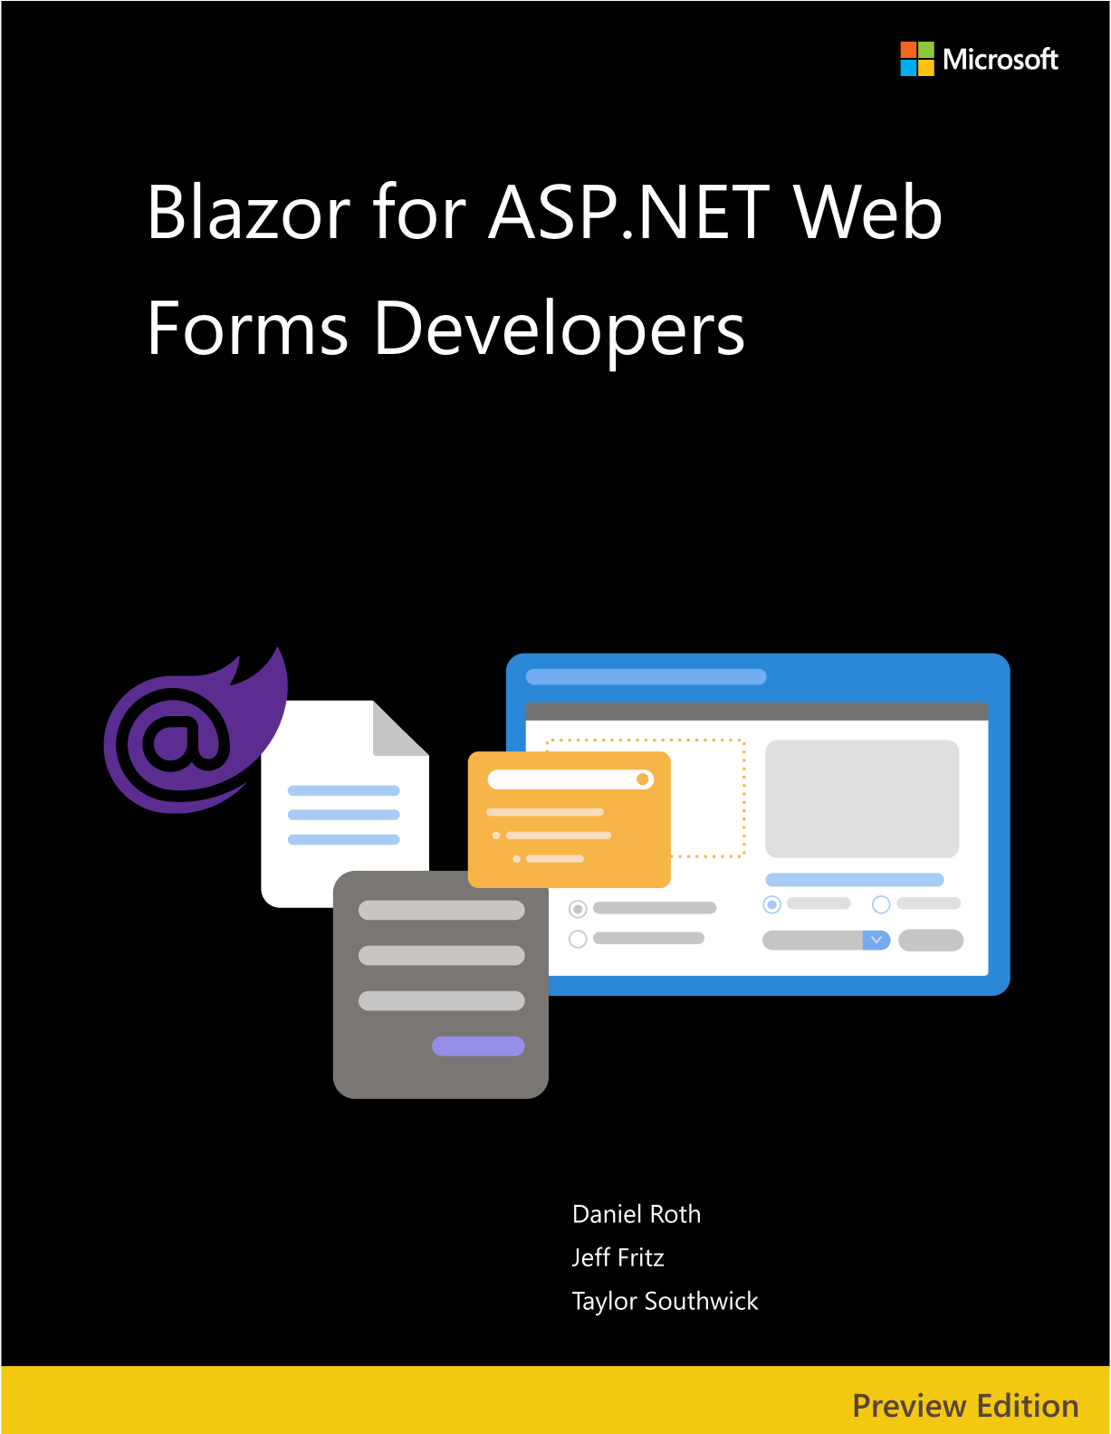


Resources
eBooks
docs.microsoft.com/dotnet/architecture/
Docs
docs.asp.net
Slides
aka.ms/new-in-aspnetcore3
Code
aka.ms/contoso-lending
Socials
@Scott_Addie

